Slide 1

Fire will kill us all
Atanas Marchev
Filippo Nardocci
Nikolay Ganev
Yosif Kiradzhiev
Stef van den Tempel

Slide 2
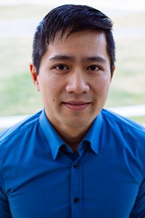
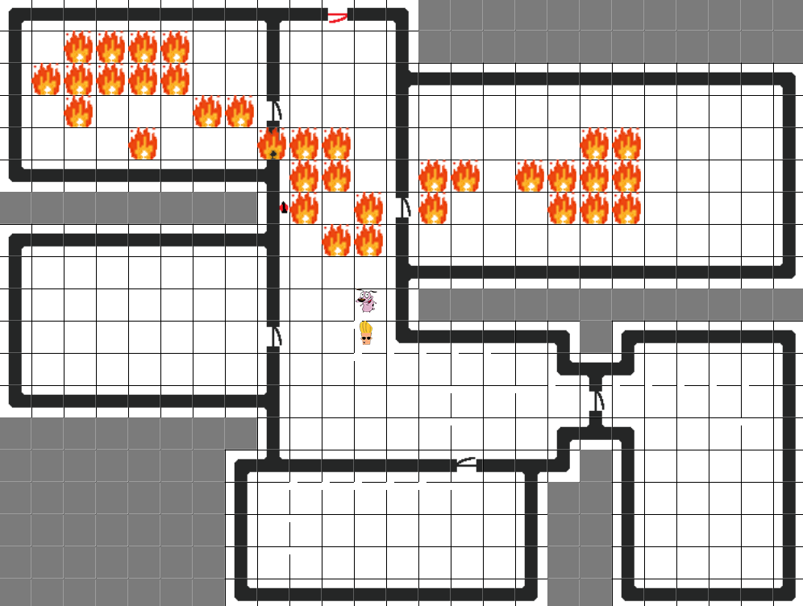
Our Assignment
Client
Fire Simulation
Random

Slide 3
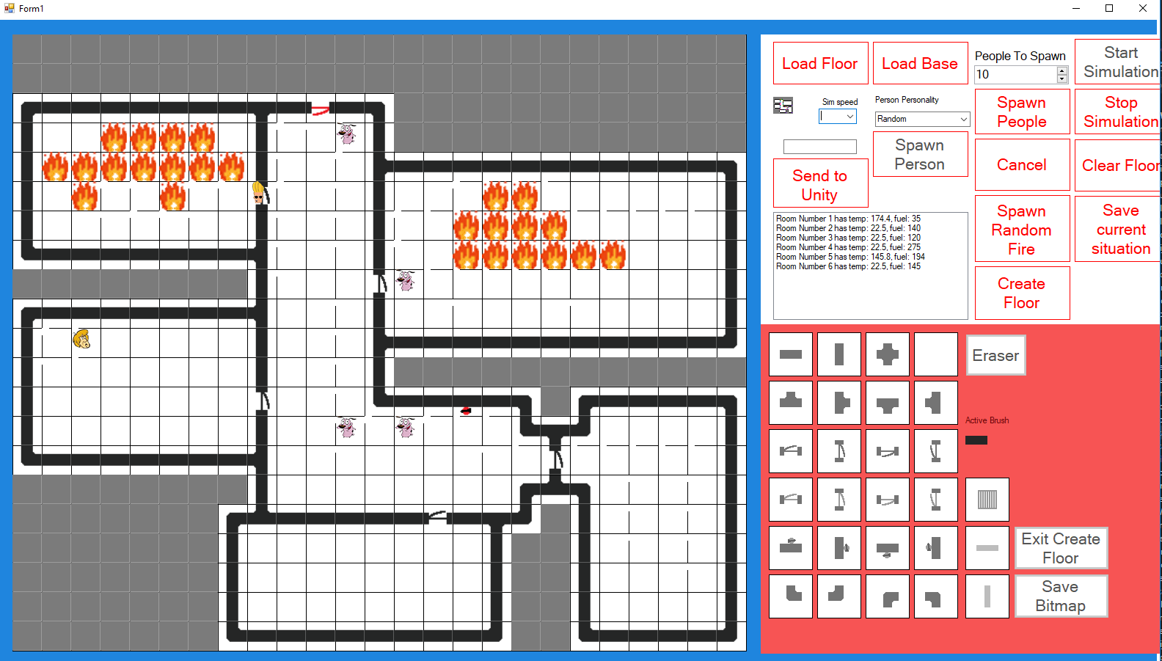
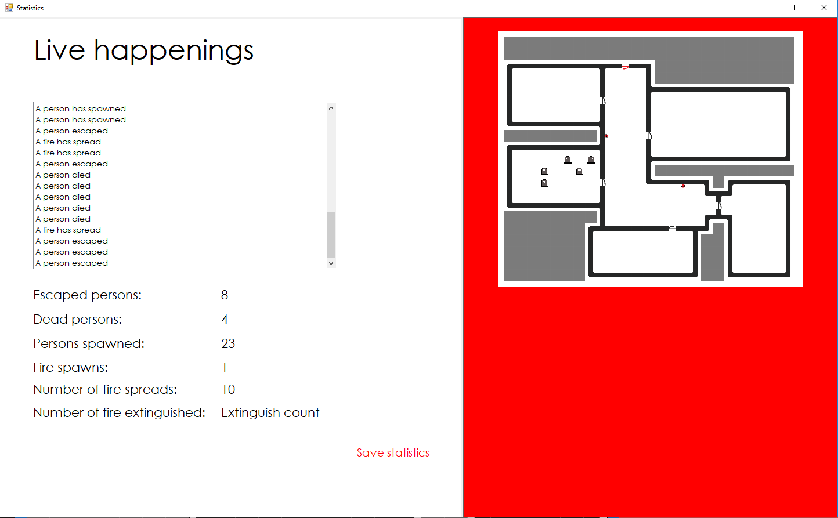
Our application
Floor creator
Simulation
Statistics

Slide 4

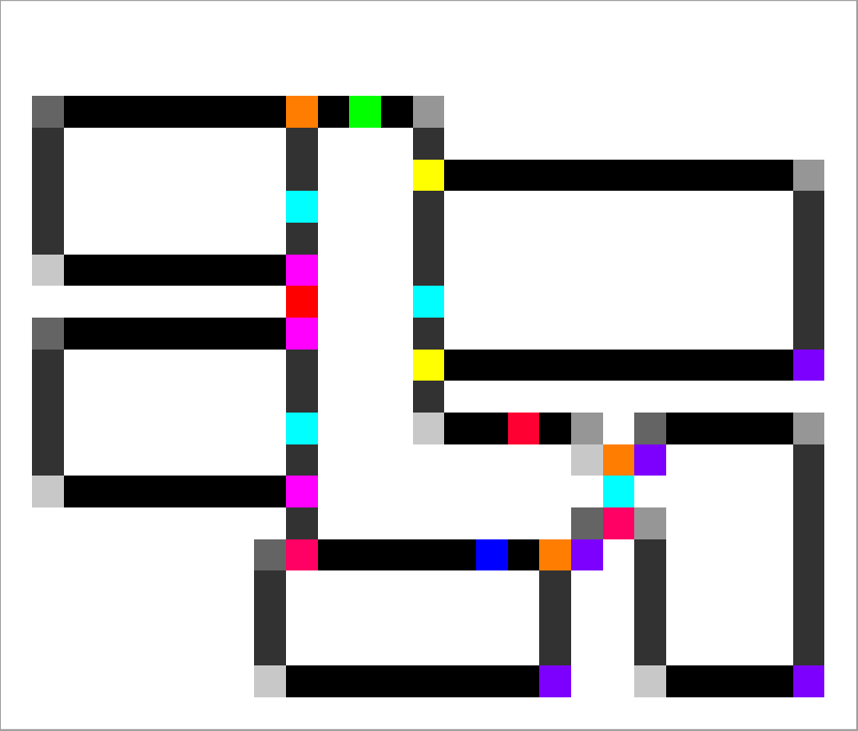
Decisions
Windows forms
Bitmap
Unity
Algorithms
Multiple simulations

Slide 5
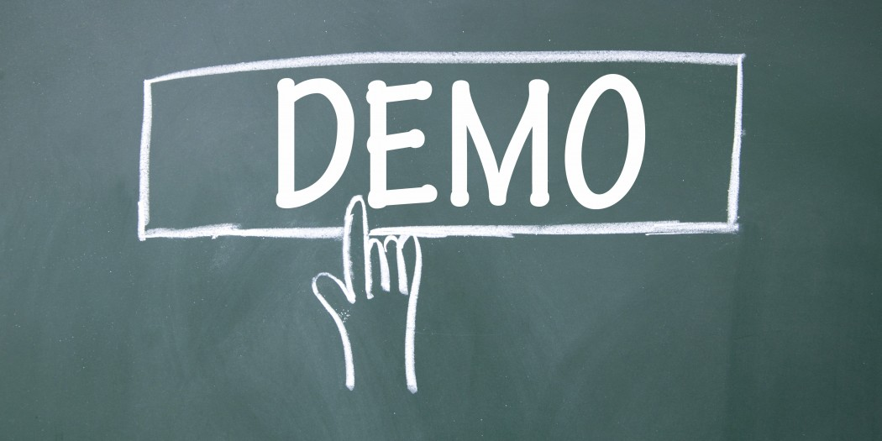
Demo

Slide 6


What did we learn? And what would we improve?

Slide 7


The end, any questions?

